Slide 1
What is Digital Information?
Mack 2021

Slide 2
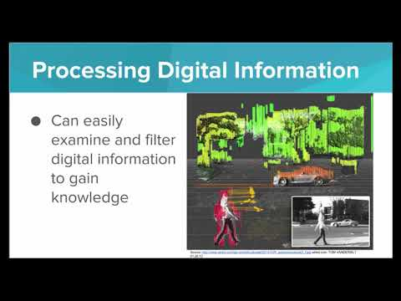
We learn about encoding meaningful information as digits, and learn about the value of representing information digitally.

Slide 3
What is data abstraction?
Notes:
🍐 This is a Pear Deck Multiple Choice Slide. Your current options are: A: Manipulating data to create something new, B: Storing data in as little space as possible, C: The process of simplifying complicated data into manageable chunks, D: Filtering data to gain new knowledge,
🍐 To edit the type of question or choices, go back to the "Ask Students a Question" in the Pear Deck sidebar.
C

Slide 4
Which of the following are examples of encoding information?
Notes:
🍐 This is a Pear Deck Multiple Choice Slide. Your current options are: A: Representing fast food meals as numbers on the menu. For example a number 1 represents a hamburger., B: Assigning a numeric value to every area of a region, for example zip codes in the United States, C: Assigning a number to every character of the alphabet so we can represent sentences as series of simple digits., D: All of the above,
🍐 To edit the type of question or choices, go back to the "Ask Students a Question" in the Pear Deck sidebar.
D

Slide 5
Example - Fast Food Menu
Try running this program to see what it does. Click continue to go to the next exercise.
https://replit.com/join/loakmybink-danmack

Slide 6
Reflection: Encodings Everywhere
There are several examples in the world where we encode crucial information using letters and numbers.
The proteins in our body can be encoded by the individual amino acids that form them (“NLYTIQ…”), and those amino acid chains can be encoded by the DNA bases that form them (“TTCGATATC…”).
Every geographic area has its own telephone area code to help route the connection for long distance calls. For example, the state of Vermont has the area code 802.
The McDonald’s menu assigns number codes to several of its most popular meals to simplify the ordering process. Number 1 is a Big Mac and Number 10 is a 10 piece chicken nugget meal.
Describe an example in your life where you encode information, or you use encoded information. Give specific examples of certain encoded values and what meanings they hold (ie 1 = “Big Mac”, 2 = “Cheesburger”, etc).
No coding in this exercise, just write down your answer to this question!

